Slide 1
WARNING
Views depicted in this presentation do not depict my personal attributes,
nor anyone I know or associate with.

Slide 2
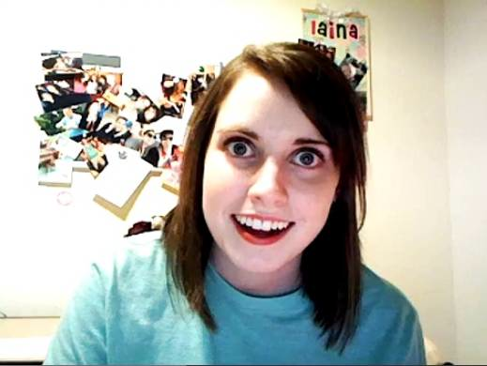
Overly Attached Girlfriend
By Brittany Nicol

Slide 3
What does she do?
Talks to you
Loves you
You are everything she’s ever looked for in a boyfriend
..You will probably hate her after talking with her for one minute
She is “insanely insane”. – Daniel Juszko

Slide 4
What is your goal?
To forget every dream you’ve ever had… your dream is now to make her the happiest girl in the world.
Ultimately, avoid getting into fights with her

Slide 5
A+ Features
Mood swings: on both accounts
What you say, do not say, or do not punctuate will affect the outcome of the conversation
5 ‘relationship fight’ situations of varying degree
Hey Vs. HEY! Vs. Hello most beautiful girl in the world
You’re busy today? We were hanging out though..
You don’t want to be together forever?
What’s your favorite food? .. If it’s a sandwich…
You’ve reached unchartered territory if you forget what month her birthday is in..
Notes:
You don’t seem excited to be talking to her
You are spending time in your daily life doing things other than hangout with your girlfriend?
-- u have commitment issues… don’t worry shell help you face them
Obviously youre a sexist and you want her to be in the kitchen making you sandwiches all day

Slide 6
Trust Issues-aka you’re cheating
Have you “fought” 5 times?
..You definitely might be cheating on the poor dear
She interrogates you
“I read your texts.. I saw you ate at Wendy’s last night.. who’s Wendy?”-OAG Meme
Take a while to respond?
Have you littered your responses with “umms” or “…”
Too many details in your response?
Not enough details?

Slide 7

But I’m not cheating!!
You better offer to buy her those Louboutin’s she’s been talking about ($800 shoes..)
Not enough money?
Beg for forgiveness
I LOVE YOU !!!
I don’t want to fight!!
Extra exclamation marks=
Extra brownie points!

Slide 8
Relationship Advice (not yet implemented)
Chances are good you’ve made her mad at least once and you have no idea why
Mr. computer will tell you exactly why you made her mad and what you need to do next time

Slide 9




Hey Boyfriend.. What’s your favorite movie??
Danuhnuhnuhnuhnuh BATMAN
You mean it’s not Twilight?! DO YOU WANT ME
TO KILL MYSELF?!?!
Oh Boyfriend.. You said Batman was your favorite movie. Do you have any sense with women?? You must know the Answer will ALWAYS be Twilight..
Notes:
Turns out she’s kidding.. She says.. Don’t think that saves you from this being brought up in a fight though

Slide 10
How does she know what to say?
Your mood can direct the conversation as well as hers
She looks for grammar, just like in real life to determine YOUR mood. (Fine. Vs. Fine!! )
The amount of fights you have is directly related to cheating accusations
You can dig your way out of a fight by saying nice things to her (I love you, hunny, dear, I’m sorry)
She’s kind of good at reading
Knows that yes, yep, ok, sure, mhm all mean yes
Notes:
Yes
no

Slide 11
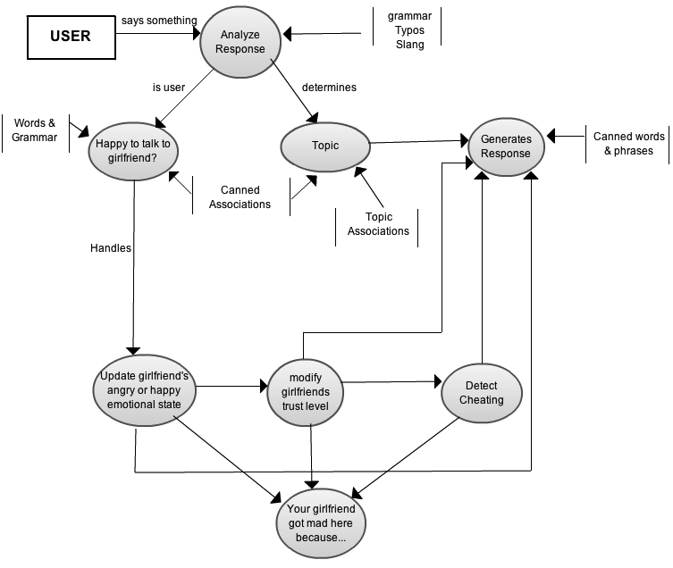
Data Flow Diagram

Slide 12
Rewards
I’m not as bad at coding as I once thought?
.. But I like the design part much more
Hilarity Ensued
Had to tap into my crazy girlfriend side
Making others tap into theirs as well

Slide 13
Challenges
Scope creep
Conversation turns were growing exponentially.
Working individually on a project
Reworking conversation to include A+ options
Trying to avoid out of context statements although it still made the conversation work well and fit with the character
Originally wanted to accuse user of cheating if he didn’t put an exclamation mark after hey
But that would have been too easy, had to add degrees of anger
Notes:
I originally wanted

Slide 14
SDLC Strengths
Incremental model with agile motto of “code for today not for tomorrow”
Strengths:
Kept everything very well defined (and on paper) before starting to code (incremental)
Allowed me to work one method at a time making sure it worked 100% before moving onto the next(code for today not for tomorrow)

Slide 15
SLDC- Would I use it again?
Would have developed a more agile approach
Had everything laid out perfectly, but then A+ options couldn’t be implemented the way I wanted it to be.
Had to go back and rework everything
Would discuss requirements and have everything VERY clearly outlined before I started planning if I were to use again

Slide 16
What's your favorite class in highschool?
Woodworking
Hmm.. I don’t really like Woodworking I like cooking! One day I will be the BEST housewife EVER. But don’t ever ask me to make you a sandwich.. That’s so rude. What’s your favorite food??
Sandwiches…..
You had better ask if I’m mad
What?? Why are you mad??
You don't care about my feelings at all. Are you completely emotionally unattached… like your father…
Wow.. My father is not emotionally unattached!!
Honestly I don't even want to hear it you were the one that put me in a bad mood you deserve me being mad at you because you are a bad boyfriend. Are you going to buy me something to cheer me up.

Slide 17
What do you want me to buy you??
Ok, so there are these $800 shoes that I just have to have. I'm a size 7. If you don't
want me to leave you for Justin Bieber( I know that he will buy them for me).. you will right?:)
Yes of course!
Oh thank the lord! I knew you were the best boyfriend ever.
But I don’t like it when you fight with me. Lets talk about how we can
Make our relationship better.
What do you think are some key qualities in a relationship?
Probably trust? Right?
yep! Like when you watch TV, I trust that if any girls come on the screen you will immediately turn it off. I trust you not to visually cheat on me.
I can’t think of anymore…
Lists the ones you missed and examples of each.. Incase you were unclear

